Slide 1
Bills don’t lie
Amir, Harsh, Matt, Rick

Slide 2
Overview
Quarterly Insights delivered through data visualization based upon core business components. RHMA Insights allows for a business to understand the true monthly/quarterly costs of a small business. Business Owners are then able to look up local business for supplies that could be advantageous to purchase from to combat high cost items.

Slide 3

Layouts
Home Page
Register
Login
Overview of what the website offers

Slide 4
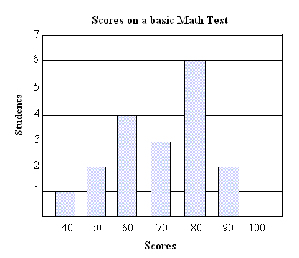
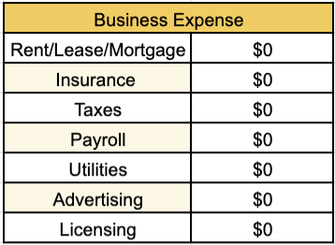
Layouts
Business Portfolio
[nav bar]
Graph related to Business growth
Expense Sheet
Data for this graph will be coming from the database where we will have dummy data for previous year
Expense sheet will have predefined items where users can plug in expense

Slide 5
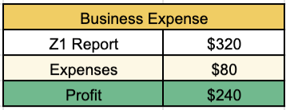
Layouts
Finances
[nav bar]
Daily/Weekly Business transactions
Expense Sheet

Slide 6


Layouts
Purchasing
[nav bar]
Purchasing List
Google Map will allow the search got closets store to purchase goods
Add item to list and click “Add”
Item 1
Add
List
Items will be added to the list and can be checked off once bought
Item 1
Item 2
Item 3

Slide 7
Roles & Responsibility

Slide 8
Schedule
May 29 - 31
June 1 - 3
June 4 -7
June 8 - 9
June 10
Complete making ppt for presentation
PRESENTATION DAY
Fix minor bug if needed

Slide 9
Project Management Board

